Slide 1


Slide 2


welcome you
To
IIT DELHI

Slide 3
Description
TASKS - The map of IITD has task symbols planted at task locations. Symbols of tasks assigned to the player will be shown on the left side of players screen. Player has to look for these symbols in IITD campus and reach their task location. Instructions on how to complete the task will be provided at the task location. Completing these tasks grants 1 coin each.
BONUS POINTS - Friends and family can also give coins.
OBSTACLES - Doctor Doof can steal coins and send player to Gate #1 of IITD campus.
LIFE - Dog bites can decrease your energy. If energy decreases to 0, you die and the other player wins. To regain energy, you can eat from few food joints. These food joints are also marked by symbols in the map but eating at these places will cost 1 coin.

Slide 4
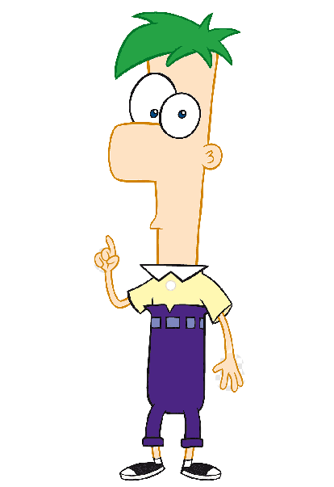
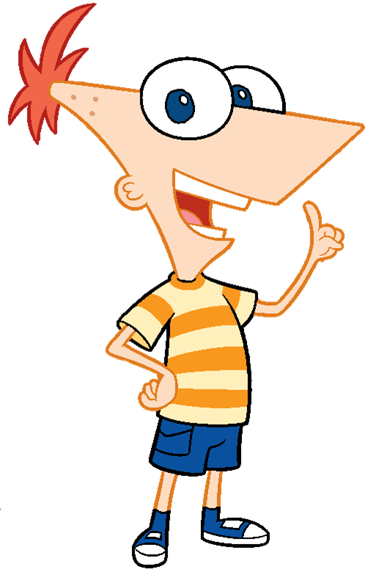
Who are Phineas and Ferb ?
These characters are taken from an American animated series called “Phineas and Ferb” that centers around two brothers - Phineas and Ferb Flynn and their adventures during summer vacation.
In this game, we depict their life as students of IITD and how the other characters help or distraught them.
As a player, you have to perform tasks and collect points. Your family and friends can also help you in gaining points. The player who collects 5 coins first wins the game.

Slide 5










TASKS
MARK ATTENDANCE in Lecture Hall Complex
PLAY CRICKET in Cricket ground
COMPLETE COL ASSIGNMENT in CSC
PLAY HOCKEY in Hockey Ground
BUY STATIONARY ITEMS from IIT Market
ISSUE BOOK from Library
EXERCISE in SAC gym
PLAY TENNIS in Tennis Court near Delhi-16
EAT LUNCH: This symbol is at 2 locations. Look for Task Instruction in both locations
ATTEND PROJECT MEETING with professor in Bharti Building.

Slide 6
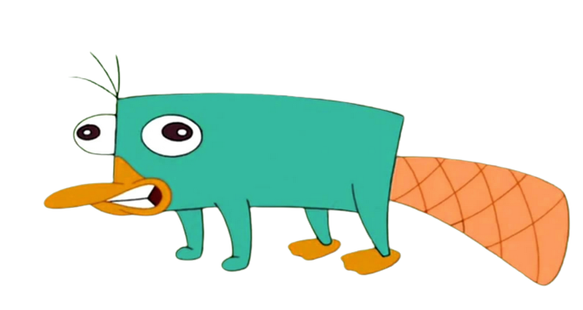
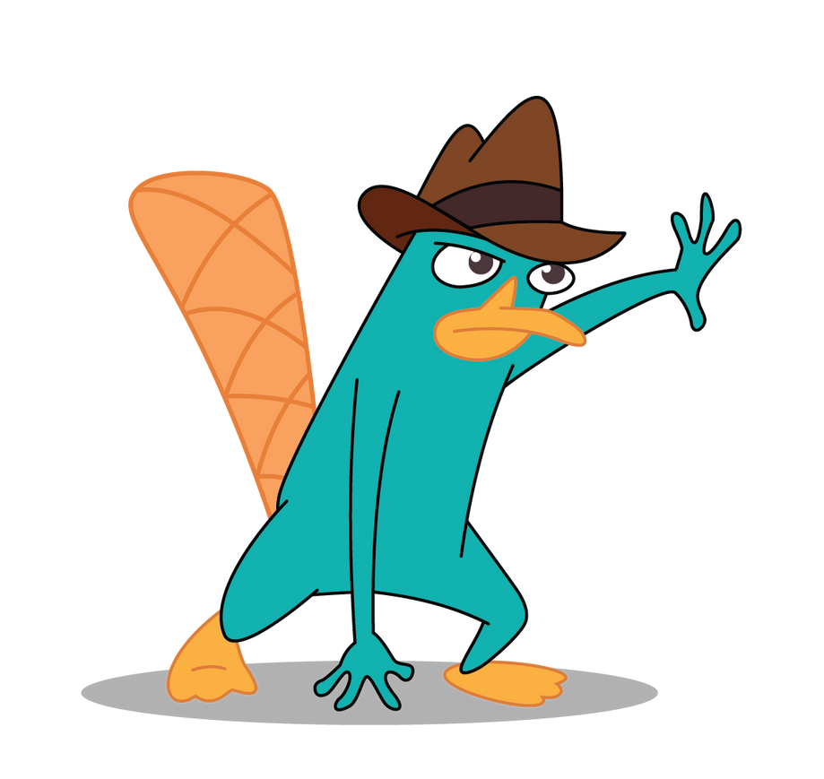
Platypus Perry - the secret agent
Perry the Platypus, code named Agent P, or simply Perry, is Phineas and Ferb's pet platypus, who, unbeknownst to his owners, lives a double life as a secret agent.
Your dear Perry will give you 2 bonus coins !!

Slide 7
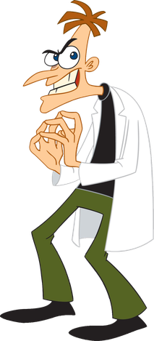
Doctor Doofenshmirtz - the main villain !
Doof is a dimwitted evil genius. His goal throughout the show is to take over the entire “tri-state area”, for which he keeps trying to make new inventions.
On the other hand, Phineas and Ferb unknowingly end up destroying his inventions everytime when they demolish their own project to hide it from their family.
You should avoid Doof in IITD as well because he is not very fond of you and will steal all your coins and send you to Gate #1.

Slide 8
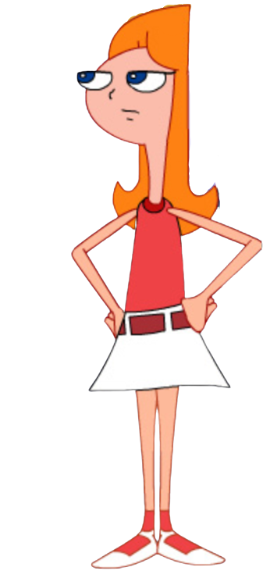
Candace - Phineas and Ferb’s Sister
Being your elder sister, Candace has the responsibility of taking care of you and helping you with college stuff.
She stays in Nalanda Hostel and can give you 1 coin if you reach out to her for help.

Slide 9
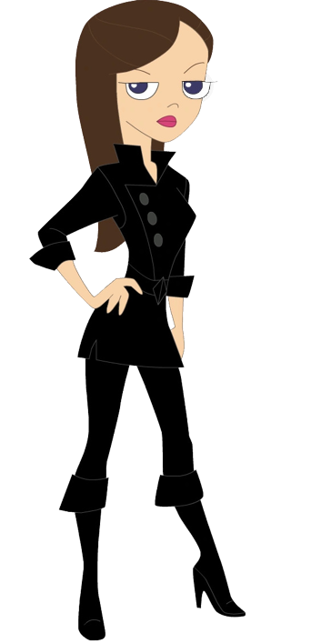

Isabella and Vanessa
Isabella is Phineas’s good friend and Phineas can get 1 coin on meeting her <3
But she is not very fond of Ferb, so Ferb can not gain coin by meeting her.
Similarly Ferb can get 1 coin on meeting Vanessa - DOOF’s daughter but Phineas cannot !!

Slide 10
Main SDL Features Used
Socket programming using SDL
Alpha Blending
Timer so that our game ends in 2 minutes
Sound effects
Collision detection
True type Fonts
Handling keyboard inputs for motion
VSync

